Slide 1
www.visionaryteaching.com

Slide 2
www.visionaryteaching.com
Visionary Teaching is pleased to offer this versatile learning resource for use by educators of all grade levels. Feel free to edit the content on individuals slides to meet the needs of your diverse learners and the content that you are teaching them.
Visit Visionary Teaching’s website to learn more about playing Would You Rather on a virtual platform.
All clipart and fonts were taken from the public domain. All content and design elements were created by Daniel Biegun.
Happy Teaching!

Slide 3
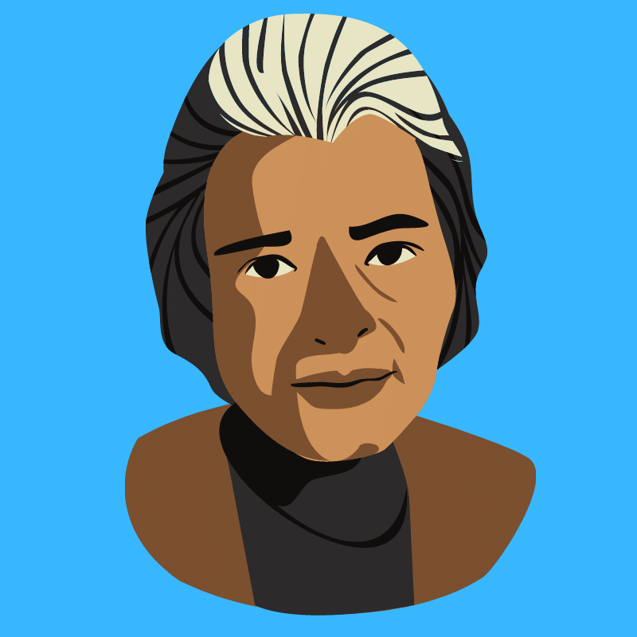
have lunch with Ben Franklin?
Would you rather:
have lunch with Rosa Parks?

Slide 4
be a famous inventor?
Would you rather:
be President of the United States?

Slide 5
hear Abraham Lincoln speak?
Would you rather:
hear Martin Luther King, Jr. speak?

Slide 6
own a factory?
Would you rather:
own a farm?

Slide 7
meet George Washington?
Would you rather:
meet Alexander Hamilton?

Slide 8
have a poem written by Maya Angelou?
Would you rather:
have a baseball used by Jackie Robinson?

Slide 9
be a Senator?
Would you rather:
be a Supreme Court Justice?

Slide 10
experience the Revolutionary War?
Would you rather:
experience World War II?

Slide 11
ride with Paul Revere?
Would you rather:
participate in the 1963 March on Washington?

Slide 12
experience the Gold Rush?
Would you rather:
experience the Industrial Revolution?

Slide 13
be able to stop the attack on Pearl Harbor?
Would you rather:
be able to stop the September 11, 2001 attacks?

Slide 14
interview a Tuskegee Airman?
Would you rather:
interview an astronaut who landed on the Moon?

